Slide 1
14. Október 2016
Sigrún Ólafsdóttir, Rannis

Slide 2
The international division at Rannís
Liaison between the European Commission (Horizon 2020) and the Icelandic research community.
Info days, presentations, counselling, NCP networks.
3 National Contact Points (NCPs) covering Horizon 2020 plus other smaller / regional European grant programs

Slide 3
HERA NET
NORFACE
Notes:
16 áætlanir til 2 ára í senn.

Slide 4
Societal Challenge 6: Europe in a changing world – inclusive, innovative and reflective societies
Economic recovery and inclusive and sustainable long-term growth with focus on co-creation for growth and inclusion: engaging citizens, users, academia, social partners, public authorities, businesses including SMEs, creative sector and social entrepreneurs.
Reversing inequalities in Europe. For more inclusive societies to take shape in the medium term, coherent visions will need to be devised on how to foster a social and economic framework that promotes fairness and sustainability in Europe.
The global environment in which the EU operates is constantly evolving. Recent developments show just how dynamically the strategic and geopolitical contexts are changing. A better understanding of Europe's cultural and social diversity and of its past will inform the reflection about present problems and help to find solutions for shaping Europe's future.
CALL: CO-CREATION FOR GROWTH AND INCLUSION
CALL: UNDERSTANDING EUROPE - PROMOTING THE EUROPEAN PUBLIC AND CULTURAL SPACE
CALL: ENGAGING TOGETHER GLOBALLY CALL: REVERSING INEQUALITIES AND PROMOTING FAIRNESS

Slide 5
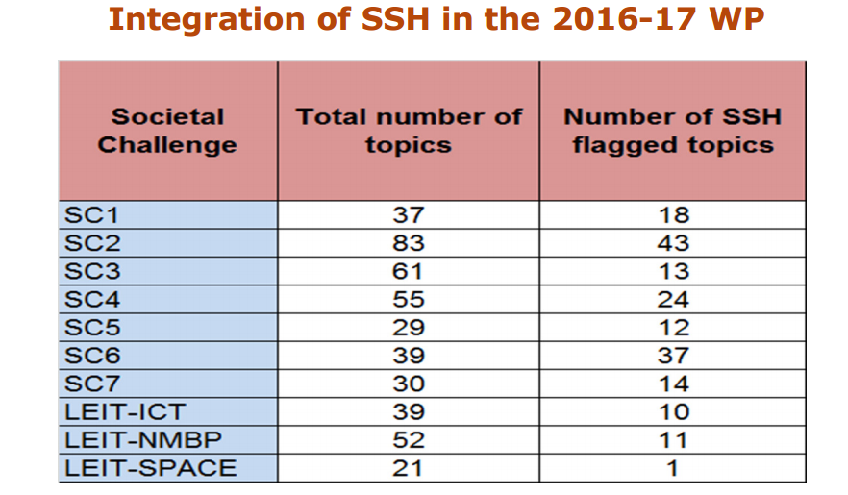
SSH flagged topics

Slide 6
Quality of SSH integration
• the share of SSH partners is higher than 10%;
• the budget going to SSH is higher than 10%;
• contributions from the SSH are well integrated in project abstract, keywords, working programmes and deliverables;
• contributions from the SSH came from at least two distinct SSH disciplines.

Slide 7
Useful links
Participant portal http://ec.europa.eu/research/participants/portal/desktop/en/home.html
SSH topics in the participant portal
http://ec.europa.eu/research/participants/portal/desktop/en/opportunities/h2020/ftags/ssh.html#c,topics=flags/s/SSH/1/1&+callStatus/asc
Oportunities for SSH Researchers in H2020 http://www.net4society.eu/public/949.php
Newsletters and ISSUES magazine: http://www.net4society.eu/public/newsletters.php

Slide 8
Writing impact into SSH proposals
instrumental (influencing policy making)
conceptual (understanding policy making)
capacity building (technical and personal skill development)

Slide 9
HERA AND NORFACE
ERA-NETS for Humanties (HERA) and Social Sciences (Norface). Co-funded by national Research Councils.
Bottom-up topics based on the ERA-NET calls.

Slide 10
HERA – Humanities Era-Net
Next call CULT-COOP-10-2017: Culture, integration and European public space. February 2017. Call for proposals from researchers autumn 2017 (?)
http://heranet.info/

Slide 11
Norface – Social Sciences Era-Net
NORFACE
REV-INEQUAL-03-2016: Dynamics of Inequality Across the Life-course
Status: Call for proposals closed, next ERA NET application in 2019?
http://www.norface.net/

Slide 12
COST
Bottom-up projects. Call for proposals 2 times a year (next December 7th).
Reasarchers can join in existing actions (projects) by applying for the action with Rannis, preferably within a year from the announced action.
http://www.cost.eu/COST_Actions

Slide 13
How to build a consortium?
Use your contacts
Brokerage events
Net4Society‘s partner search and research directory (for SC6). Other NCP network partner searches.
Don‘t forget SMEs (in H2020)
Gender equality http://garciaproject.eu/wp-content/uploads/2015/12/GARCIA_working_paper_6.pdf https://genderedinnovations.stanford.edu/

Slide 14
How to find previously funded projects?
Horizon 2020: CORDIS http://cordis.europa.eu/home_en.html
HERA http://heranet.info/hera-joint-research-programme-1 and http://heranet.info/hera-joint-research-programme-2
NORFACE
http://www.norface.net/programmes/

