Slide 1
PURE
PROJECT DATABASE REGISTRATION
How we do at Copenhagen Business School
By Senior Research Adviser Annedorte Vad
av.research@cbs.dk – telefon +45 38152082

Slide 2
INTRODUCING PURE
CBS uses PURE to register information on activities related to externally funded projects
Use of data
pre-award and post-award support to the researcher
Information to the management Head of Departments and Secretariats, Researchers etc.
Statistics, reports, prognosis
Journaling to the Government

Slide 3
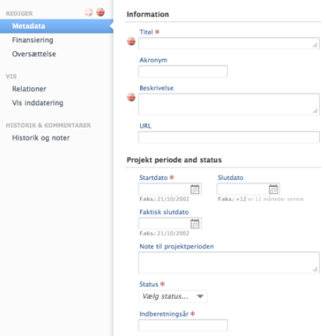
PROJECT METADATA
Title
Acronym
Description
URL
Project period
Status
Year

Slide 4
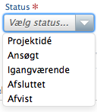
PROJECT STATUS
Records the project life cycle
Projekt idea
Applied
Current
Completed
Rejected

Slide 5
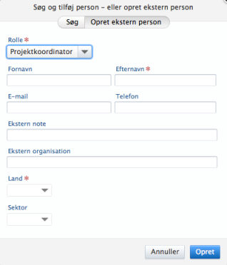
PROJECT PARTICIPANTS
We work with four categories
Project Coordinator either from CBS or externally
Project leader. Used for the main CBS person
Project participant. All other CBS participants
Project administration. Pre-Award and Post-Award personelle

Slide 6
PROJECT PARTNERS
Eksternal organisations are entered into the system
Including contact data for the Coordinator

Slide 7
PROJECT DOCUMENTS
After submission the final documents are
Application
Budget
Partnership agreement
Contract and annexes
Other relevant material
These documents are relevant for the post-award team and uploading them we fulfill our obligations regarding registration to the government.

Slide 8
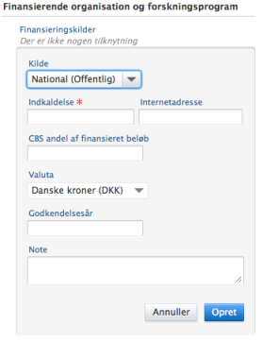
PROJECT FINANCING
Source
National Public
National privat
EU
International Public
International private
Seed funding
Call information, sum applied for, year of the grant approval and notes is added

Slide 9
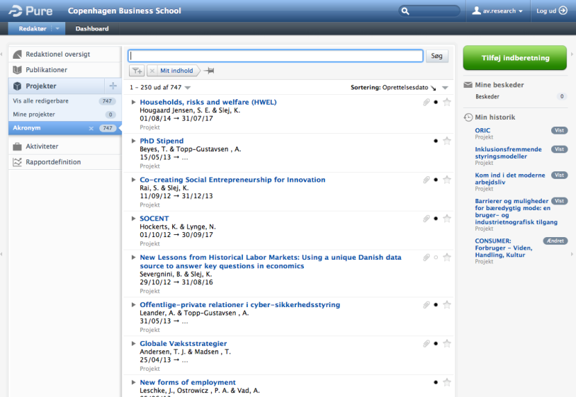
EASY OVERVIEW
Notes:
For hvert projekt kan du se de oplysninger der er tastet ind, og som blev gennemgået før

Slide 10
PROJECT INFORMATION

Slide 11
USE OF PURE DATA REPORTING SERVICES
A number of reports allows us to easy report to the management, head of departments etc.
Activity report (including project ideas and rejected)
Project report (funded projects)
Yearly report with data for the President

Slide 12
USE OF PURE DATA PRE-AWARD
Head of department and secretariat
Information on activities at department level
Information on each researcher
Success rates and trends
The Researcher
Information on activities in relevant research area(s)
Information on participation in current projects
Information on former applications and interests
Use this information to find new relevant calls

Slide 13
USE OF PURE DATA POST-AWARD
Head of department and secretariat
Information on current projects at the department
Information on researchers activity
The researcher
Project information and relevant documents collected
Work procedures
Prognosis for future projects – work load planning
In the future – financial information from the central finance system?

Slide 14
MANAGEMENT INFORMATION
If the information in PURE is accurate and complete we can deliver reports to the management in minutes
Activity across CBS, at department level or researcher level
Current projects and sum
Success rates
Prognosis
Statistics

Slide 15
MARKETING AT CBS.DK
PURE data for current and completede projects will be displayed at cbs.dk.
Marketing of CBS research
Marketing of externally financing
Marketing of projects
Marketing of CBS researcher’s network and activity in externally funded projects

